Slide 1

EXTERNAL PROJECT VIVA 2022-2023
Parul Institute of Computer Applications
Semester 4 Project -II
2022-2023
Team members
210510312003 – Kartik Gupta - F
210510314001 – Garvit Bucha - F

Slide 2
INDEX
Abstract
Tools and Technology Used
Features of Proposed System
Limitation of Proposed System
Users and their role description
System Flow Diagram
Data Flow Diagram ( All Levels)
Use Case Diagram
Class diagram
Er diagram
Data Dictionary
Screenshots of Development Phase 1 ( Designing of your Project)
Screenshots of Development Phase 2 ( Features Implementation)
Screenshots of Development Phase 3 ( Features Implementation)
Future Enhancement
Conclusion
References

Slide 3
ABSTRACT
The purpose of the project entitled as “HOSPITAL MANAGEMENT SYSTEM” is to computerize the Front Office Management of Hospital to develop software which is user friendly simple, fast, and cost – effective. It deals with the collection of patient’s information, diagnosis details, etc. Traditionally, it was done manually. The main function of the system is register and store patient details and doctor details and retrieve these details as and when required, and to manipulate these details meaningfully System input contains patient details, diagnosis details, while system output is to get these details on to the screen. The Hospital Management System can be entered using a username and password. It is accessible either by an administrator or receptionist. Only they can add data into the database. The data can be retrieved easily. The data are well protected for personal use and makes the data processing very fast.

Slide 4
TOOLS AND TECHNOLOGIES USED
FRAMEWORK: Android
CONTROL PANEL: Android
DATABASE: Json , SQLITE
EDITOR: Android Studio
Programming languages:
Java(Backend)
XML (Designing)

Slide 5
FEATURES OF PROPOSED SYSTEM
Patient Management.
Appointment Scheduling
Medical record management
Secure Data Management
Reporting and Analysis

Slide 6
USER AND THEIR ROLE DESCRIPTION
Admin: manage department of hospitals, user, doctor, nurse, pharmacist, laboratories accounts, watch appointment of doctors, watch transaction reports of patient payment, Bed, ward, cabin status, watch blood bank report, watch operation report, watch birth report, watch diagnosis report, watch death report.
Patient: View appointment list and status with doctors, View prescription details, View medication from doctor, View doctor list, View blood bank status, View operation history, Manage own profile

Slide 7
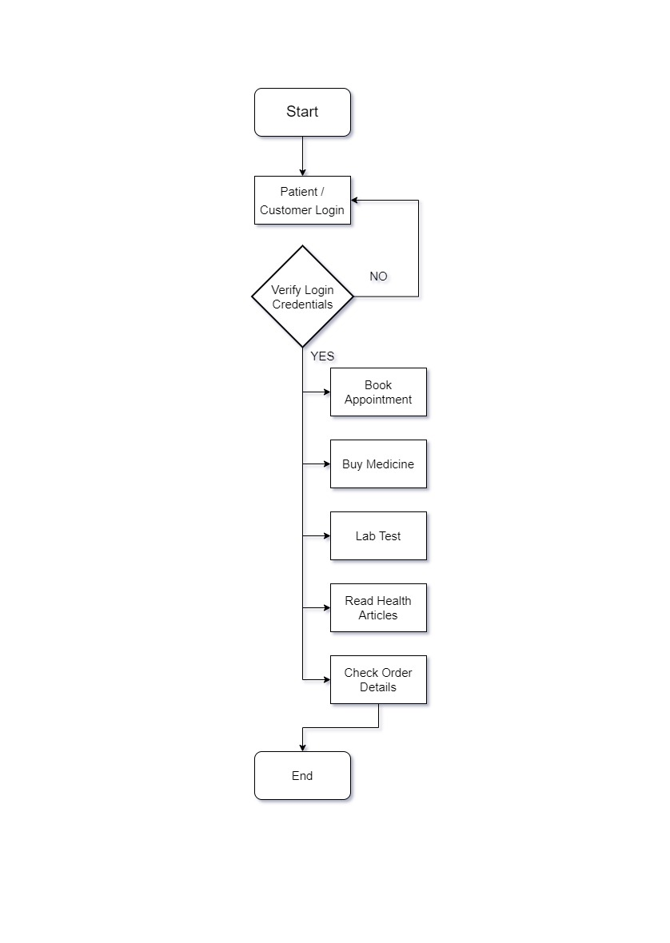
SYSTEM FLOW DIAGRAM

Slide 8
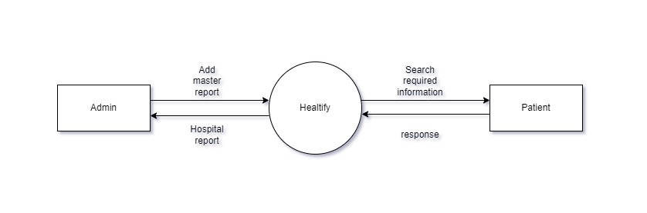
DATA FLOW DIAGRAM
Context Level DFD: 0 Level

Slide 9
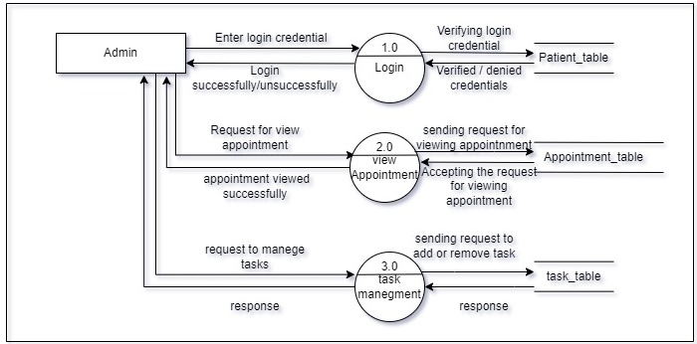
DATA FLOW DIAGRAM
Level 1 DFD: Admin

Slide 10
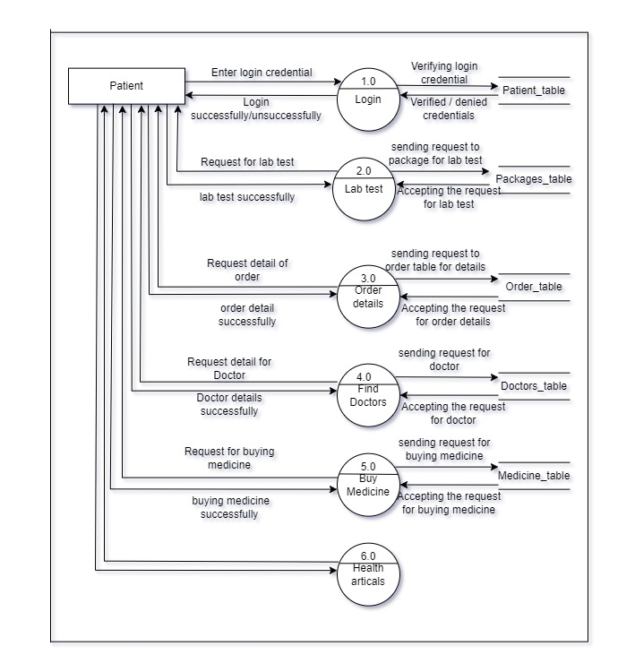
DATA FLOW DIAGRAM
Level 1 DFD: Patient

Slide 11
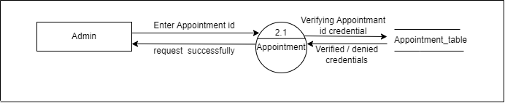
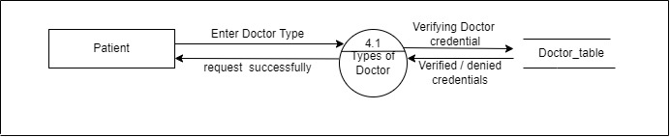
DATA FLOW DIAGRAM
Level 2 DFD: Admin
Level 2 DFD: Patient

Slide 12
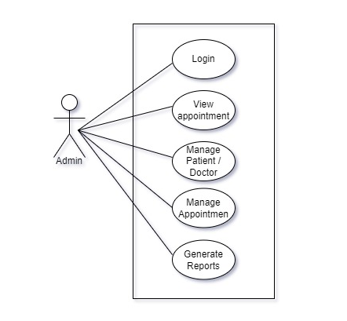
USE CASE DIAGRAM
Use Case Diagram: Admin

Slide 13
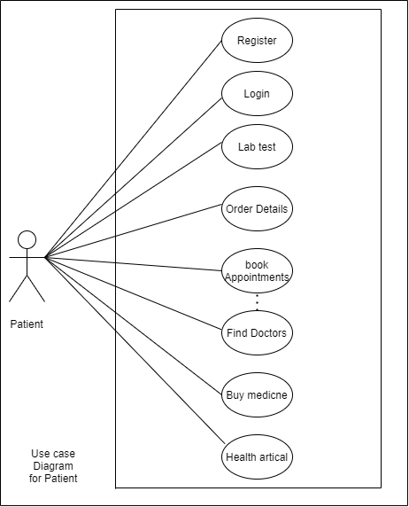
USE CASE DIAGRAM
Use Case Diagram: Patient

Slide 14
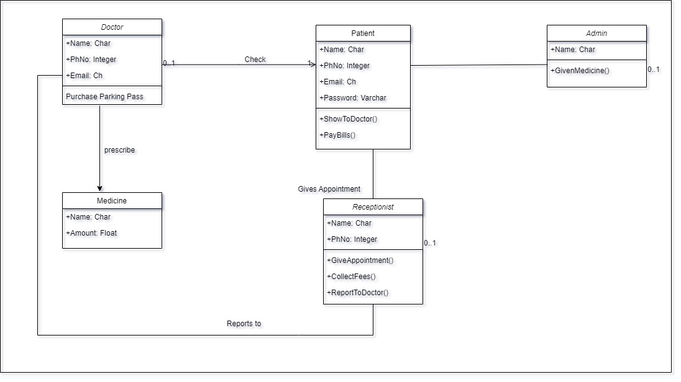
CLASS DIAGRAM

Slide 15
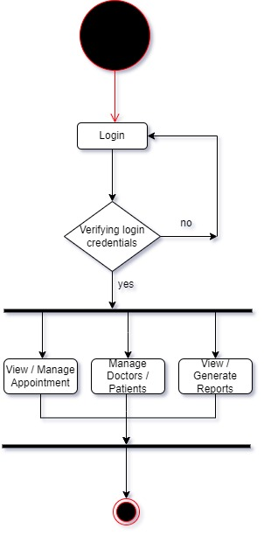
ACTIVITY DIAGRAM
Activity Diagram ADMIN :

Slide 16
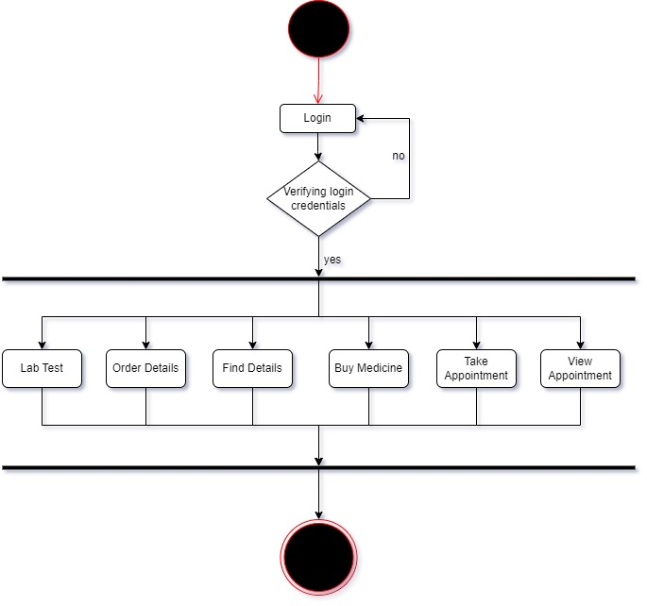
ACTIVITY DIAGRAM
Activity Diagram PATIENT :

Slide 17
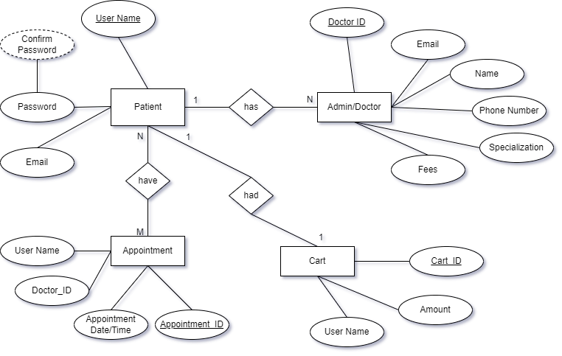
ER DIAGRAM

Slide 18
DATA DICTIONARY
1.Patient_TABLE
Sr. No | Field Name | Datatype | Size | Description | Constraint | Example
1 | Patient Id | int | 15 | Unique id of the Patient | PRIMAERY KEY | 1234567890
2 | Name | varchar | 15 | Name of the Patient | NOT NULL | Garvit Bucha
3 | Address | varchar | 30 | Address of the Patient | NOT NULL | Rajkot Gujarat
4 | Phone number | Int | 10 | 10 digits phone number of patient | NOT NULL and UNIQUE KEY | 1234567890
5 | Email | varchar | 15 | Email of Patient | NOT NULL and UNIQUE KEY | abc@gmail.com

Slide 19
DATA DICTIONARY
2. Doctors_table
Sr. No | Field Name | Datatype | Size | Description | Constraint | Example
1 | Doctor Id | int | 15 | Unique id of the Doctor | PRIMAERY KEY | 1234567890
2 | Name | varchar | 15 | Name of the Doctor | NOT NULL | Kartik Gupta
3 | Specialization | char | 30 |  | NOT NULL
4 | Phone number | Int | 10 | 10 digits phone number of patient | NOT NULL and UNIQUE KEY | 1234567890
5 | Email | varchar | 15 | Email of Doctor | NOT NULL and UNIQUE KEY | abc@gmail.com
6 | Address | varchar | 15 | Address of doctor | NOT NULL | Rajkot Gujarat

Slide 20
DATA DICTIONARY
3. Appointment_table
Sr. No | Field Name | Datatype | Size | Description | Constraint | Example
1 | Appointment Id | int | 15 | Unique id of the Appointment no. | PRIMAERY KEY | 1234567890
2 | Patient Id | int | 15 | Unique id of the Patient | PRIMAERY KEY | 1234567890
3 | Doctor Id | int | 15 | Unique id of the Doctor | PRIMAERY KEY | 1234567890
4 | Appointment date and time | int | 12 | Unique date and time | NOT NULL | 14-02-2023 / 11:00
5 | Appointment status | char | 10 | Conformation Status of appointment | UNIQUE KEY | Scheduled, Cancelled, Completed.

Slide 21
DATA DICTIONARY
4. billing_table
Sr. No | Field Name | Datatype | Size | Description | Constraint | Example
1 | Billing Id | int | 15 | Unique id of the Doctor | PRIMAERY KEY | 1234567890
2 | Patient Id | int | 15 | Unique id of the Patient | PRIMAERY KEY | 1234567890
3 | Total amount charged | int | 5 | Amount paid by patient | NOT NULL | 1500/-
4 | Payment Status | char | 10 | Payment paid status by patient | NOT NULL and UNIQUE KEY | Paid, outstanding, processing ,etc.

Slide 22
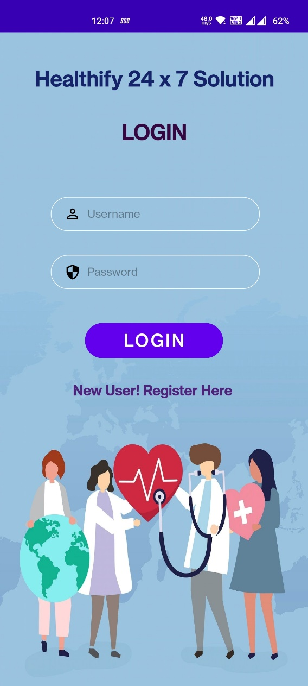
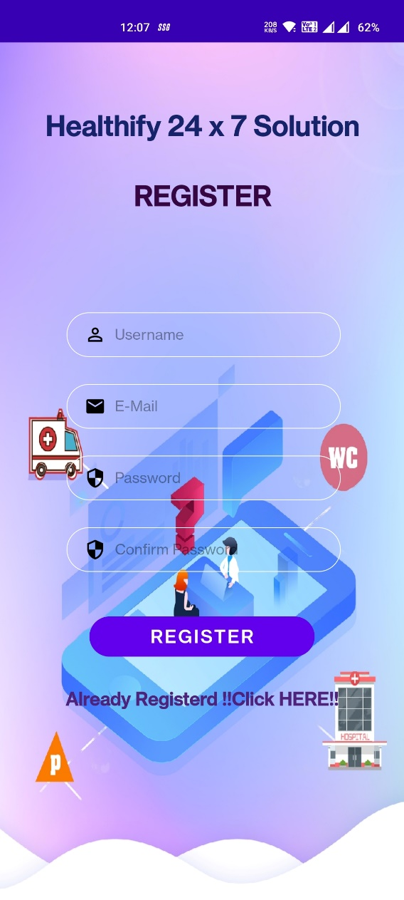
SCREENSHOTS OF DEVELOPMENT PHASE 1
DEVELOPMENT
PHASE 1

Slide 23
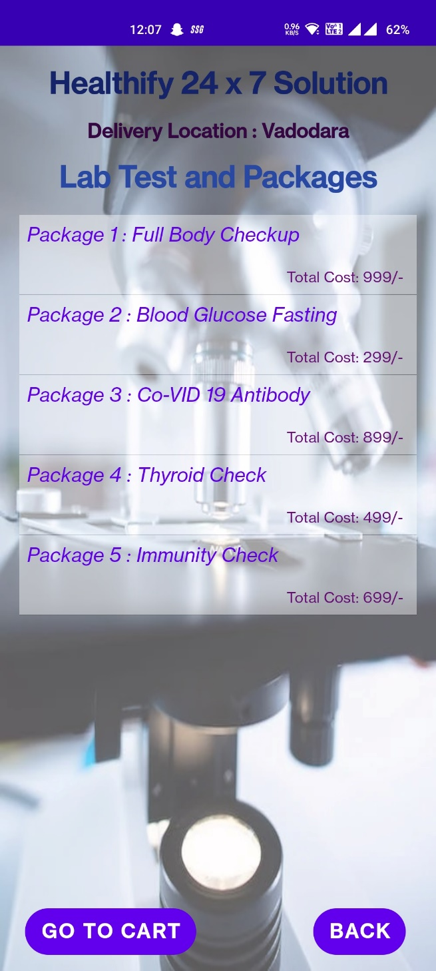
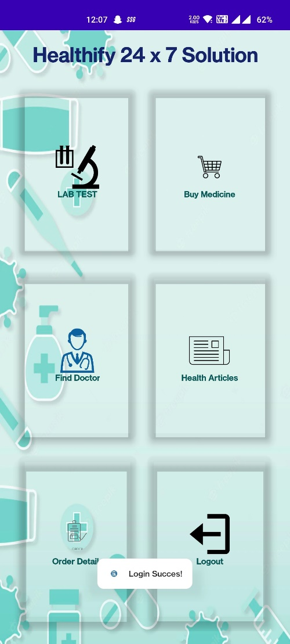
SCREENSHOTS OF DEVELOPMENT PHASE 2
DEVELOPMENT
PHASE 2

Slide 24
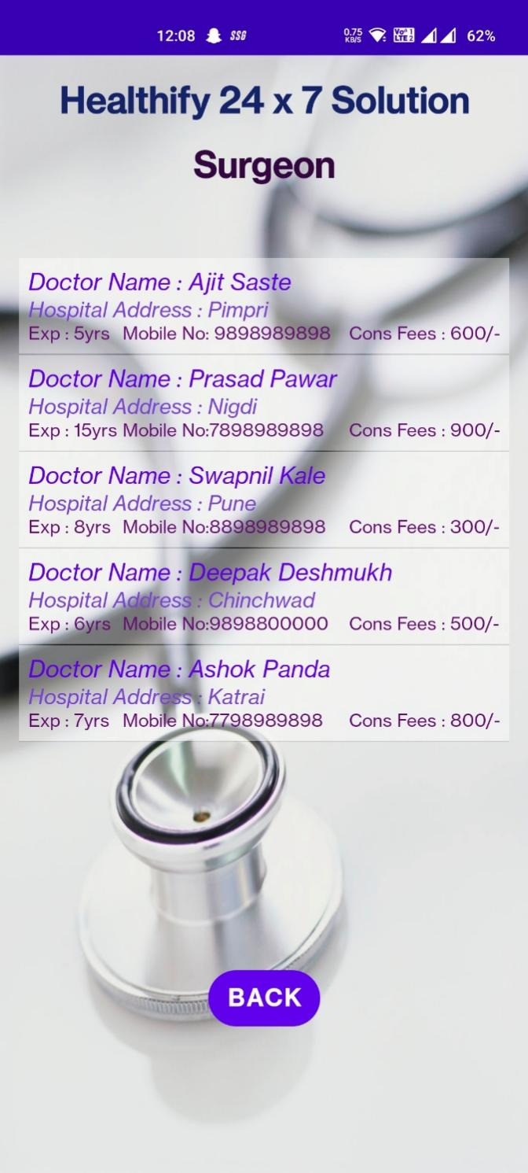
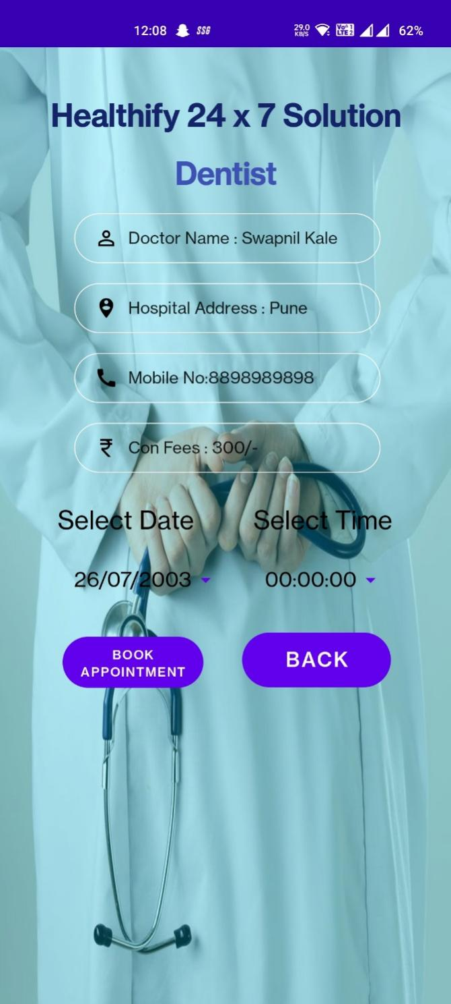
SCREENSHOTS OF DEVELOPMENT PHASE 3
DEVELOPMENT
PHASE 3

Slide 25
FUTURE ENHANCEMENT
Live doctor check-up via video call.
Due to emergency, sometimes doctors are not available in clinics, so via the facility of video calls doctor can give treatment to patient.
Complete payment Mechanism.
There should be a complete payment module will be implemented so that a patient can pay in any online payment method according to their convenience.
Real-Time Medicine/Test order updates.
The customer/patient can see the updates of the medicine/ test updates by the notifications and will state that at what status are they currently.
Updates for Regular Health Check-ups.
There should be module which can inform the patient about their check-ups by which patient gets their check-ups done more conveniently.

Slide 26
CONCLUSION
In conclusion, the hospital management system we have developed is a comprehensive solution for managing patients, doctors, and administrative tasks. Our system provides an intuitive user interface for patients, doctors, and administrators to manage appointments, medical records, billing, and other related tasks. The use of modern technologies such as mobile applications and cloud-based storage ensures that the system is efficient, scalable, and accessible from anywhere. The system's modular design also allows for easy customization and integration with other systems as needed. Overall, our hospital management system improves patient care and satisfaction, streamlines administrative tasks, and enhances the overall efficiency of the hospital.

Slide 27
REFERENCES
Website:
w3schools.com
javapoint.com
developers.android.com
youtube.com
Resources:
Guide – Prof. Manish Joshi
Teacher – Prof. Priyavat Dwivedi
Books:
Android Wireless Application Development by Lauren Darcey and Shane Conder, Pearson Education, 2nd ed. (2011)
Professional Android 2 Application Development by Reto Meier, Wiley India Pvt Ltd (2011)
Beginning Android, by Mark L Murphy, Wiley India Pvt Ltd (2009)
Pro Android, by Sayed Y Hashimi and Satya Komatineni, Wiley India Pvt Ltd (2009)

Slide 28
THANK YOU

